Slide 1
WEEK 2 INTERNSHIP REPORT
Network Traffic Analysis • Nmap • Windows Security Logging
DG Interns Hub | Ghanisth Mittal | 30 October 2026

Slide 2
Week 2 Overview
• Focus: network traffic analysis, Nmap reconnaissance and Windows security event monitoring.
• Six TryHackMe rooms reported complete, with individual writeups.
• Practical work used Kali Linux, Metasploitable 2 and a Windows 11 laptop.

Slide 3
Objectives
• Understand TCP handshake and teardown.
• Identify DNS, HTTP and ICMP traffic in Wireshark.
• Perform authorised host, port, service and OS scans with Nmap.
• Investigate Windows events and export records with PowerShell.

Slide 4
Lab Environment
• Kali Linux: 192.168.144.128
• Metasploitable 2: 192.168.144.129
• Windows: personal Windows 11 laptop
• Tools: Wireshark, Nmap 7.99, Event Viewer, PowerShell and TryHackMe.
• Nmap scans were restricted to the authorised local lab target.

Slide 5
TryHackMe Rooms
• Nmap
• Live Host Discovery
• Basic Port Scans
• Windows Basics
• Windows Fundamentals 1
• Windows Fundamentals 2

Slide 6
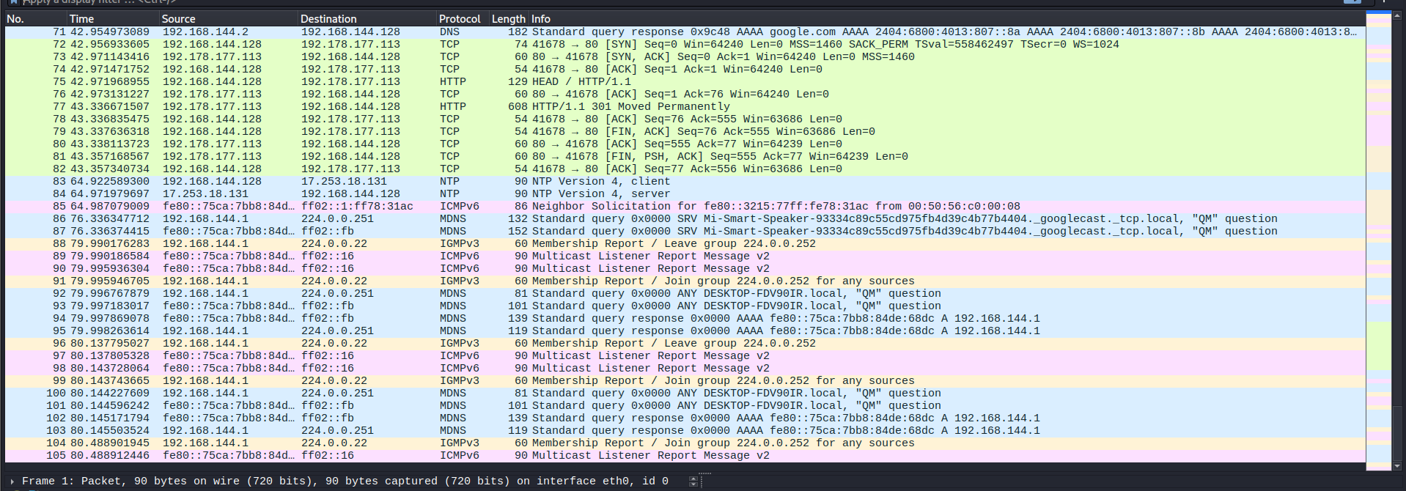
Wireshark Live Capture
• Captured traffic on Kali eth0.
• Observed TCP SYN → SYN-ACK → ACK and FIN/ACK teardown.
• Observed DNS queries and responses for google.com.
• Observed HTTP HEAD and 301 response; also captured an HTTP GET.
• Observed four ICMP echo requests and four replies to 8.8.8.8.
Live Wireshark capture

Slide 7
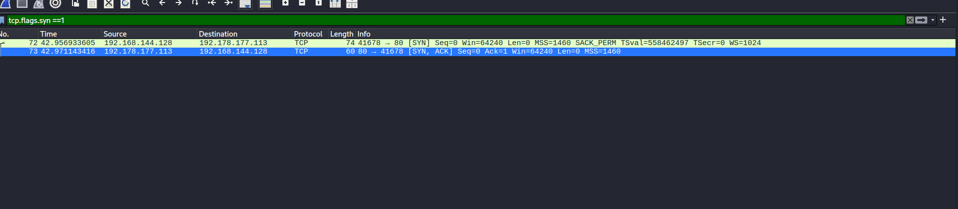
Wireshark Filters
• tcp — TCP traffic
• dns — DNS queries and responses
• http — HTTP requests and responses
• icmp — ping traffic
• tcp.flags.syn == 1 && tcp.flags.ack == 0 — initial SYN packets
Initial TCP SYN packets

Slide 8
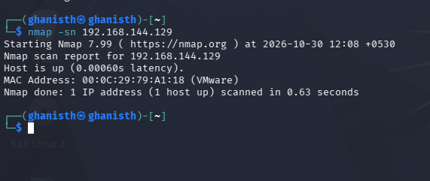
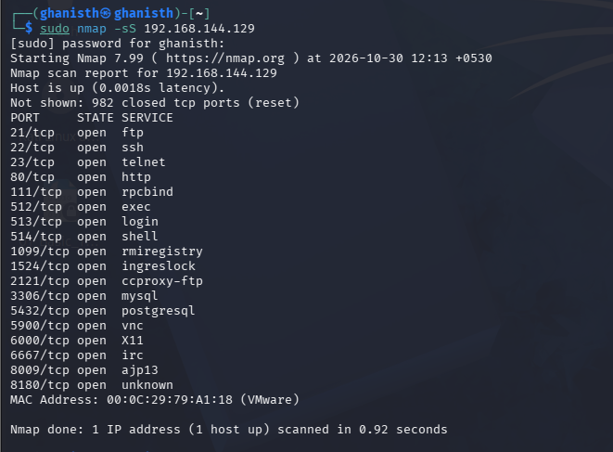
Nmap Scanning
• Host discovery (-sn): target reported up.
• SYN scan (-sS): 18 open TCP ports and 982 closed TCP ports in captured output.
• Service detection (-sV): identified service names and versions.
• OS detection (-O): estimated Linux 2.6.x.
• Aggressive scan (-A): OS, version, scripts and traceroute information.
Host discovery
TCP SYN scan

Slide 9
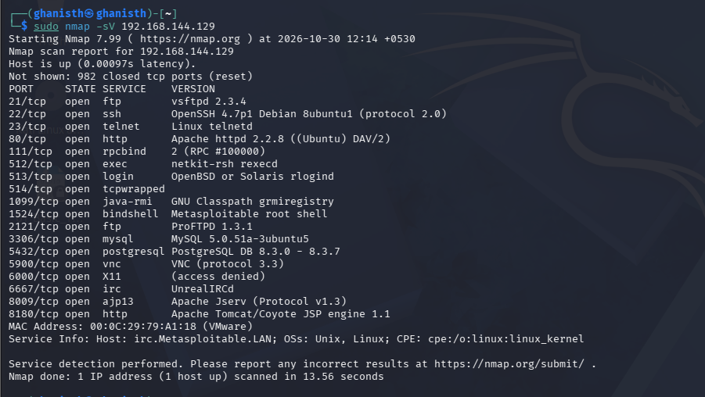
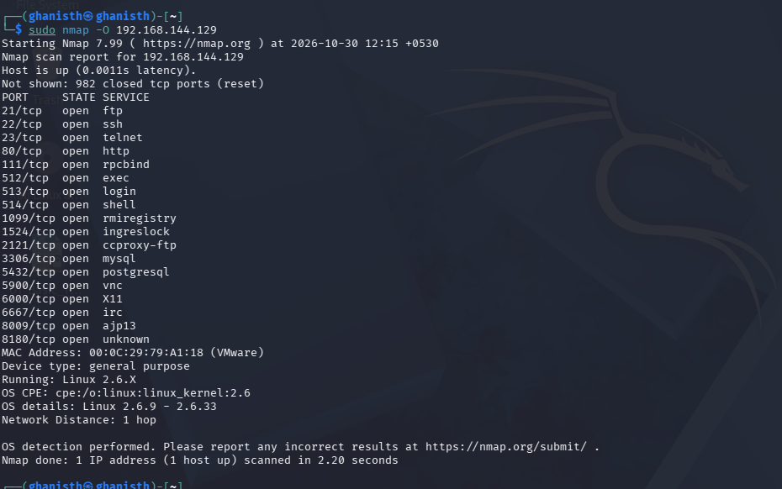
Selected Services
• 21/tcp FTP — vsftpd 2.3.4
• 22/tcp SSH — OpenSSH 4.7p1
• 23/tcp Telnet; 80/tcp HTTP — Apache httpd 2.2.8
• 3306/tcp MySQL; 5432/tcp PostgreSQL; 5900/tcp VNC
• 6667/tcp IRC; 8009/tcp AJP13; 8180/tcp HTTP/Tomcat-related service
Service and version detection
OS detection

Slide 10
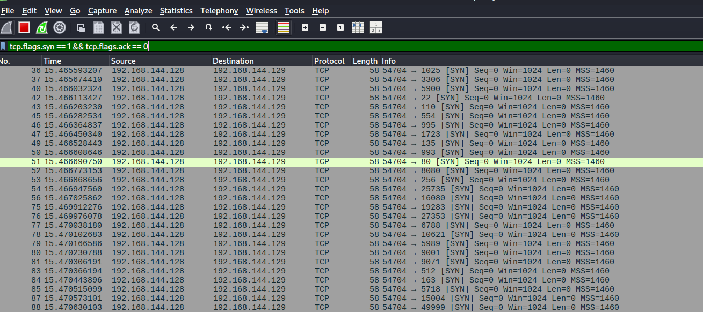
Nmap Packet Analysis
• Captured scan traffic in Wireshark.
• Applied tcp.flags.syn == 1 && tcp.flags.ack == 0.
• Observed initial SYN packets from Kali to Metasploitable.
• Packet-level evidence illustrates how SYN scanning probes TCP ports.
Nmap packets in Wireshark

Slide 11
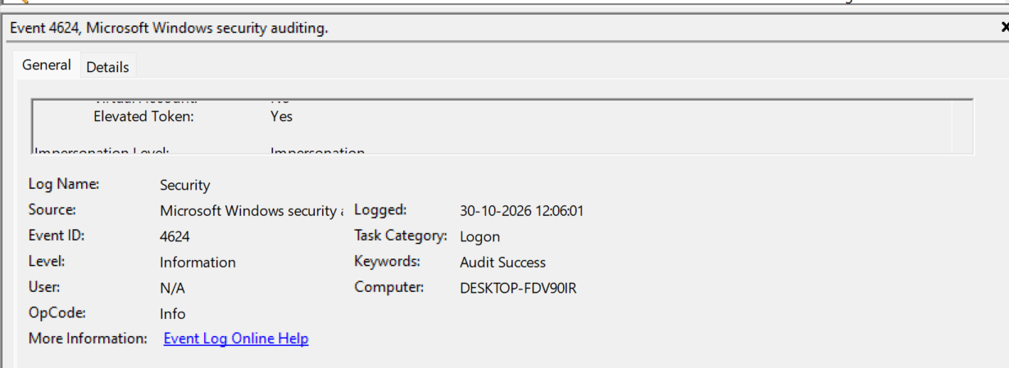
Windows Event Viewer
• 4624 — successful logon; 4625 — failed logon.
• 4720 — user account created; 4732 — member added to local security group.
• 7045 — service installed (System log).
• 1102 — Security audit log cleared; not found in available history and not forced.
• Temporary test accounts were removed after controlled exercises.
Windows Event ID 4624

Slide 12
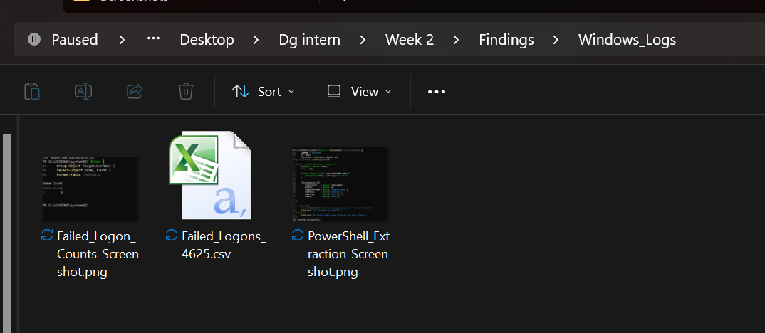
PowerShell Event Analysis
• Queried Security Event ID 4625 with Get-WinEvent.
• Used a 30-day time window.
• Exported event records to Failed_Logons_4625.csv.
• Grouped available failed-logon records by target account.
Windows log evidence folder

Slide 13
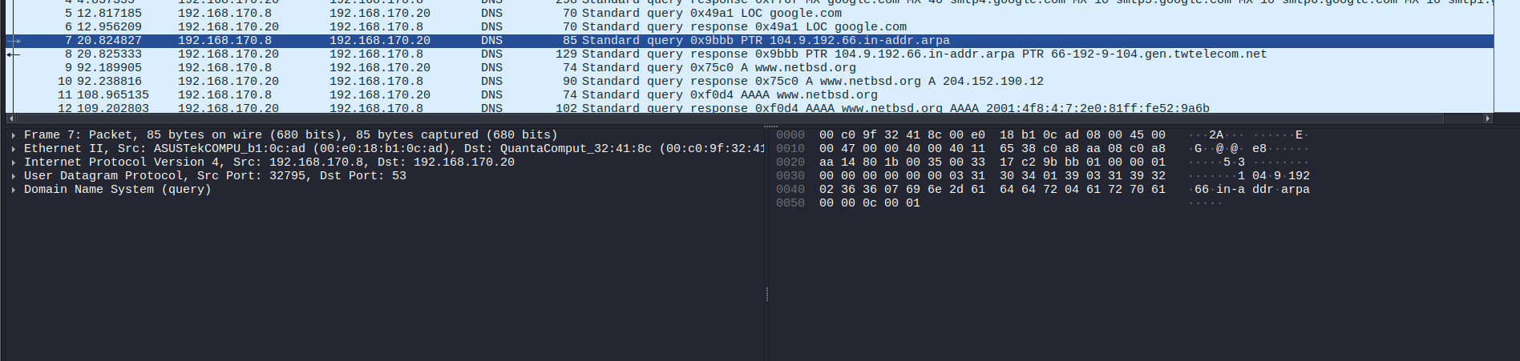
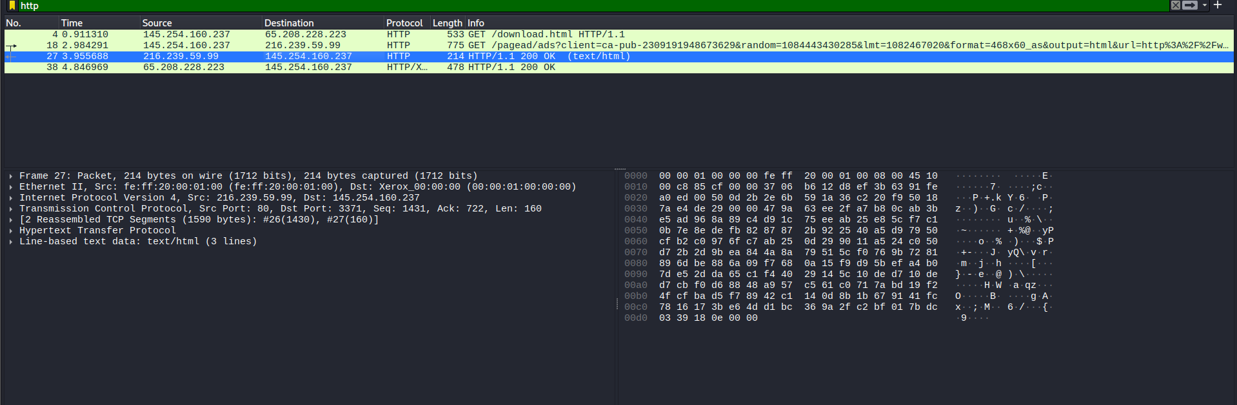
Sample PCAP Analysis
• dns.cap — PTR lookup and A/AAAA lookups for www.netbsd.org.
• http.cap — GET /download.html and HTTP/1.1 200 OK.
• ipv4frags.pcap — IPv4 fragmentation carrying ICMP; reassembly indicated in packet 2.
• Prepared three sample analysis writeups and screenshots.
DNS sample analysis
HTTP sample analysis

Slide 14
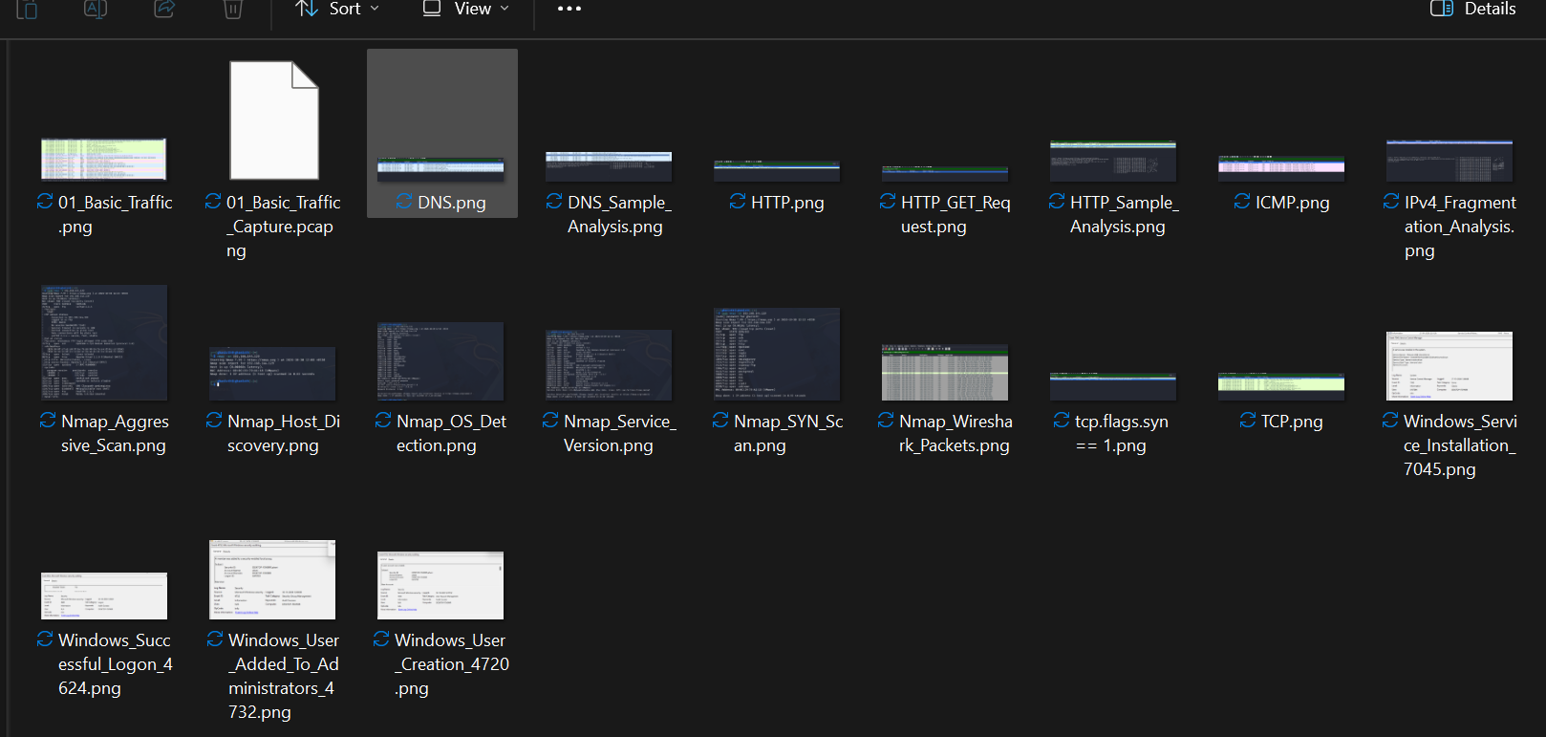
Documentation and Evidence
• Eight theory notes and six TryHackMe writeups.
• Wireshark and Windows Event ID cheat sheets.
• Wireshark and Nmap practical writeups and screenshots.
• PCAP captures, sample analysis documents and PowerShell CSV evidence.
Capture evidence folder

Slide 15
Learning Outcomes
• Improved packet-level protocol analysis.
• Practised host discovery, port scanning and service identification.
• Learned to interpret Windows Security and System events.
• Used PowerShell to retrieve, group and export event data.
• Improved technical reporting and evidence organisation.

Slide 16
Limitations and Responsible Practice
• Windows exercises used the personal Windows 11 laptop because no Windows VM was available.
• Event ID 1102 was not observed; the Security log was not cleared to create it.
• Metasploitable scans were restricted to the authorised lab VM.
• Some Nmap text-output and separate Nmap PCAP files may still need adding if available.

Slide 17
Conclusion
• Week 2 combined network-level and host-level security analysis.
• Wireshark showed protocol and packet behaviour.
• Nmap identified active hosts, open ports, services and OS information in the lab.
• Event Viewer and PowerShell supported Windows event investigation.
• The work strengthened foundational SOC and network security skills.

Slide 18
THANK YOU
DG Interns Hub — Week 2

